Slide 1
Detecting Fraudulent Click Traffic
Mentored by:
DSO 530, Professor Xin Tong
Prepared by:
9751080834 Yi-Chun Chi
7928478072 Mahalakshmi Raghavan
8151412391 Riddhi Malviya
7724267639 Ushita Palande
2919525948 Yu (Yolanda) Luo
Contact Person:
Yi-Chun Chi
chiyichu@usc.edu

Slide 2
Team members
Yi-Chun Chi
Mahalakshmi Raghavan
Riddhi Malviya
Yu ( Yolanda) Luo
Ushita Palande

Slide 3

Agenda
1
Business Problem
2
Data Description
3
Feature Selection
4
Statistical Methods
5
Final Approach
6
Result
7
Future Prospect

Slide 4
1
Business Problem
2
Data Description
3
Feature Selection
4
Statistical Methods
5
Final Approach
6
Result
7
Future Prospect

Slide 5
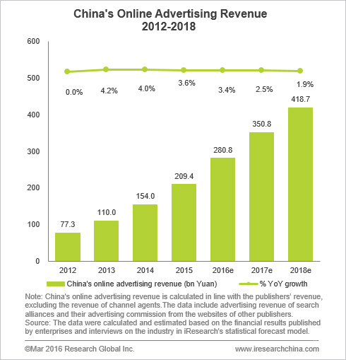
Business Problem
TalkingData, a big data service platform, which deals with more than 3 billion clicks per day, reported that around 90% of the clicks are potentially fraudulent.
Fraudulent Click: When a user (person/script/computer program) clicks a link but never ends up installing your app or buying the product
With fraudulent clicks, the conversion rate decreases so much that the campaign does not remain profitable

Slide 6
1
Business Problem
2
Data Description
3
Feature Selection
4
Statistical Methods
5
Final Approach
6
Result
7
Future Prospect

Slide 7
Data Description
Data Source
Original dataset
After Feature Engineering
Data divided
TalkingData Challenge on Kaggle
1.5 million rows
1.5 million rows
Train : 1 million rows
Test : 0.5 million rows
74 columns
Columns like IP, App, device, os etc.

Slide 8
Agenda
1
Business Problem
2
Data Description
3
Feature Selection
4
Statistical Methods
5
Final Approach
6
Result
7
Future Prospect

Slide 9
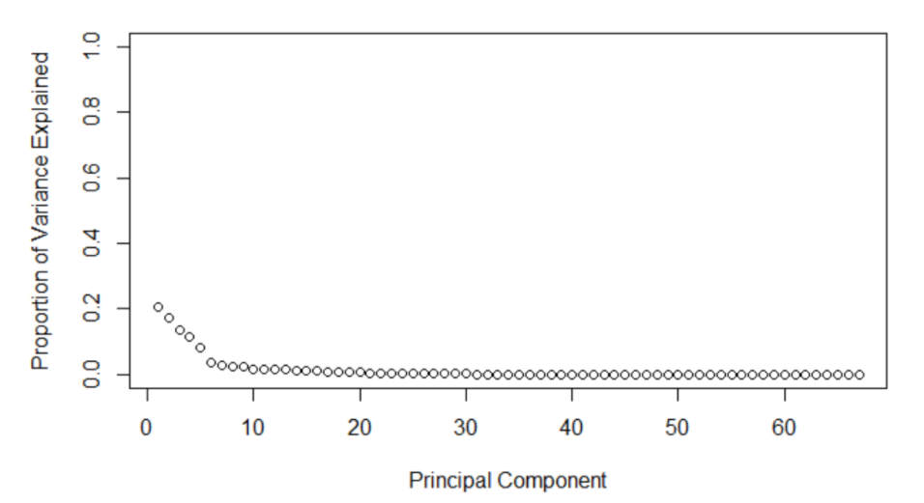
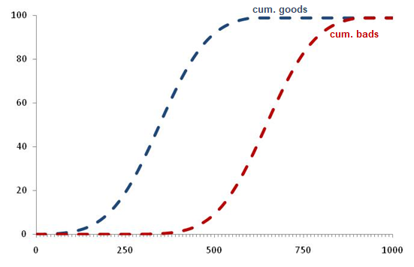
Feature Selection
Why feature selection?
Methods:
PCA: Principal Component Analysis
KS : Kolmogorov Smirnov

Slide 10
1
Business Problem
2
Data Description
3
Feature Selection
4
Statistical Methods
5
Final Approach
6
Result
7
Future Prospect

Slide 11
STATISTICAL METHODS : Metrics used to evaluate
Data characteristics
Metrics
Precision
= $\frac{TP}{FP+TP}$
Precision
= 𝑇𝑃/(𝐹𝑃+𝑇𝑃)
Highly imbalanced
( s >> s )
One type of error more significant
ROC AUC
TPR
=$\frac{TP}{FN+TP}$
TPR
=𝑇𝑃/(𝐹𝑁+𝑇𝑃)
Class label
PC 1
0
1
PC 2
Notes:
After feature selection, we moved on to trying the models. We started by looking at a scatter plot of the data, in terms of PC1 and PC2 (which explain the highest variance of the data), it was clear that the classes are imbalanced, there were many more 0s (denoted by the black dots) compared to 1’s (denoted by blue dots). Our final goal here is prediction. The meaningful metrics to evaluate models will be the area under the roc curve. As the ROC auc score moves closer to 1, our model is closer to predicting no false positives.
Receiver Operating Characteristic area under curve (ROC AUC)
Precision Recall area under curve (PR AUC) – does not consider true negatives, thus unaffected by Class imbalance

Slide 12
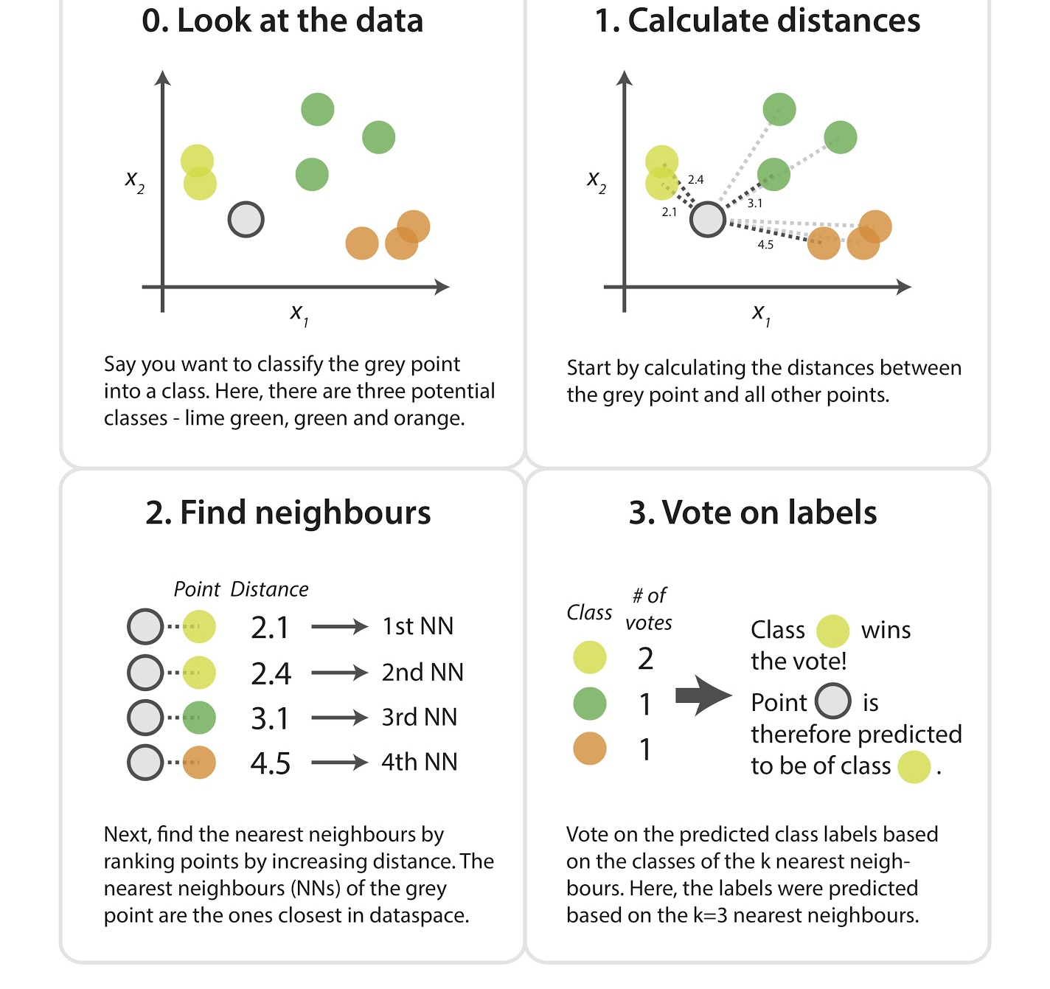
STATISTICAL METHOD : KNN
Parameter : K = 20
Tuning : Class label 1 higher weightage
Performed on PC's
Notes:
The first method is used was knn. The problem with knn was that since the class label 0’s are much higher than 1’s, based on majority voting, the model will never predict 1. thus, we did some tuning in the 3rd step of knn so that if any 1 of the nearest neighbor is 1, the observation is assigned to 1 because we didn’t want to miss the clicks which actually downloaded the app.
Only performed on PC’s, so that variables are normalized.
Otherwise, because of how KNN works, the Euclidian distance of some variables might have higher weightage based on their numerical value

Slide 13
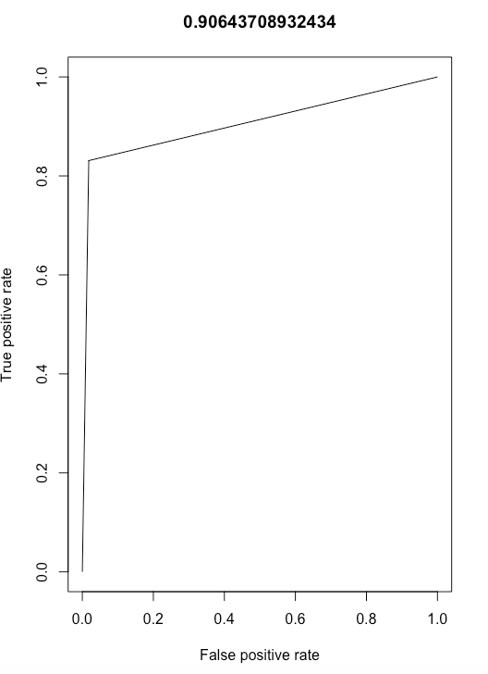
RESULTS
KNN : RESULTS
1524
310
9015
489151
AUC SCORE :
90.64%
PRECISION :
14.45%
TRUE POSITIVE RATE :
83.1%
Notes:
The roc and tpr are good enough at 90 and 83%, but precision is very low, which means out of the predicted 1s, only 15% are actually 1s.
Trade off
We got a low
The roc and tpr are good enough at 90 and 83%, but precision is very low, which means out of the predicted 1s, only 15% are actually 1s
But as you can see, it’s predicting my false positives as very high

Slide 14
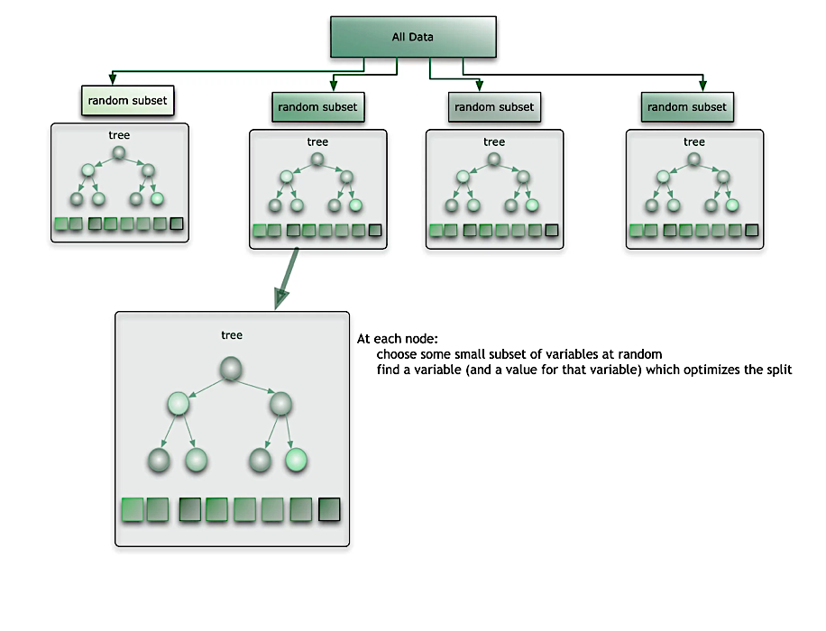
STATISTICAL METHOD : Random Forest
Number of trees: n = 100
Importance of predictors should be assessed
Performed on variables obtained from KS +RF
Notes:
In random forest, we use an ensemble of decision trees to get a better AUC score. This method creates a model with high number of decision trees. In general, if we have more trees, we tend to have higher accuracy, limited by computational capacity or budget. In our model, we used 100 trees, and performed it on variables obtained from KS as explained by Maha, on the 34 variables obtained by KS, we fed them to the RF and obtained 20 most important variables, RF also provides the importance of each variable.

Slide 15
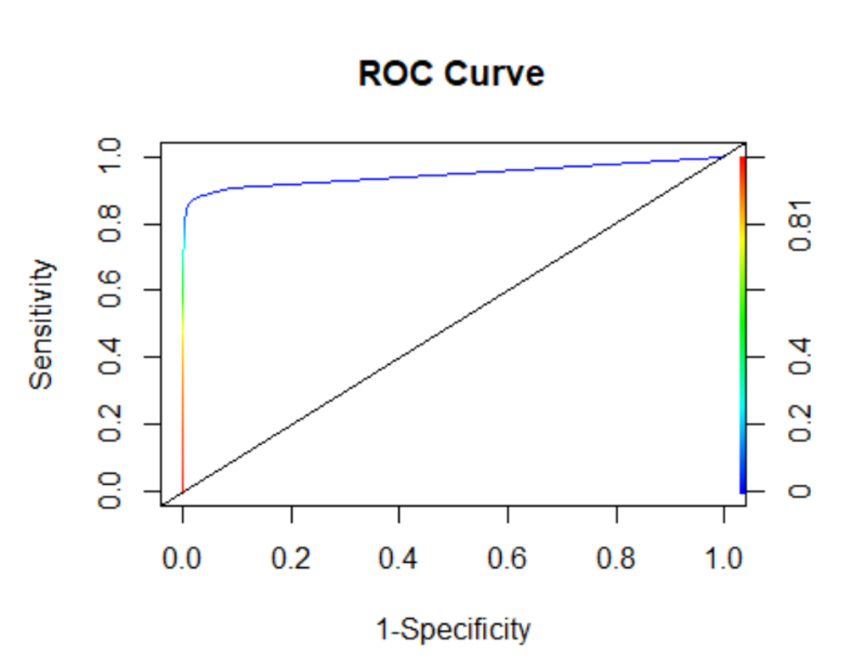
RESULTS
Random Forest : RESULTS
1088
746
191
497975
AUC Score
95 %
Precision
85.06%
True Positive Rate
59.32%

Slide 16
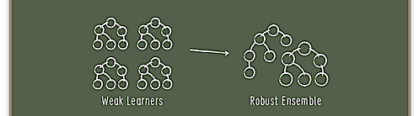
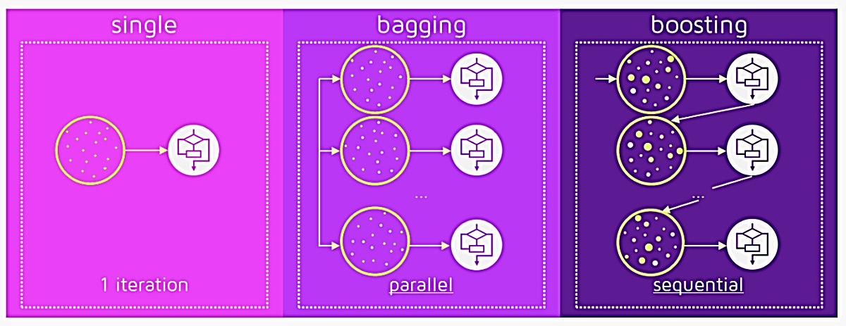
STATISTICAL METHOD : Boosting
Parameters: n=2000, λ=0.001, depth=1
Performed on all numeric variables and got relative influence
Tuning : will tune # of trees and shrinkage in next step
Decision tree
Random forest
Gradient boosting
Notes:
In boosting, it takes multiple weak decision trees, and give weights to them based on their predicting power.
We have used the gradient boosting (also called adaptive boosting) .
Smaller lambda – higher accuracy

Slide 17
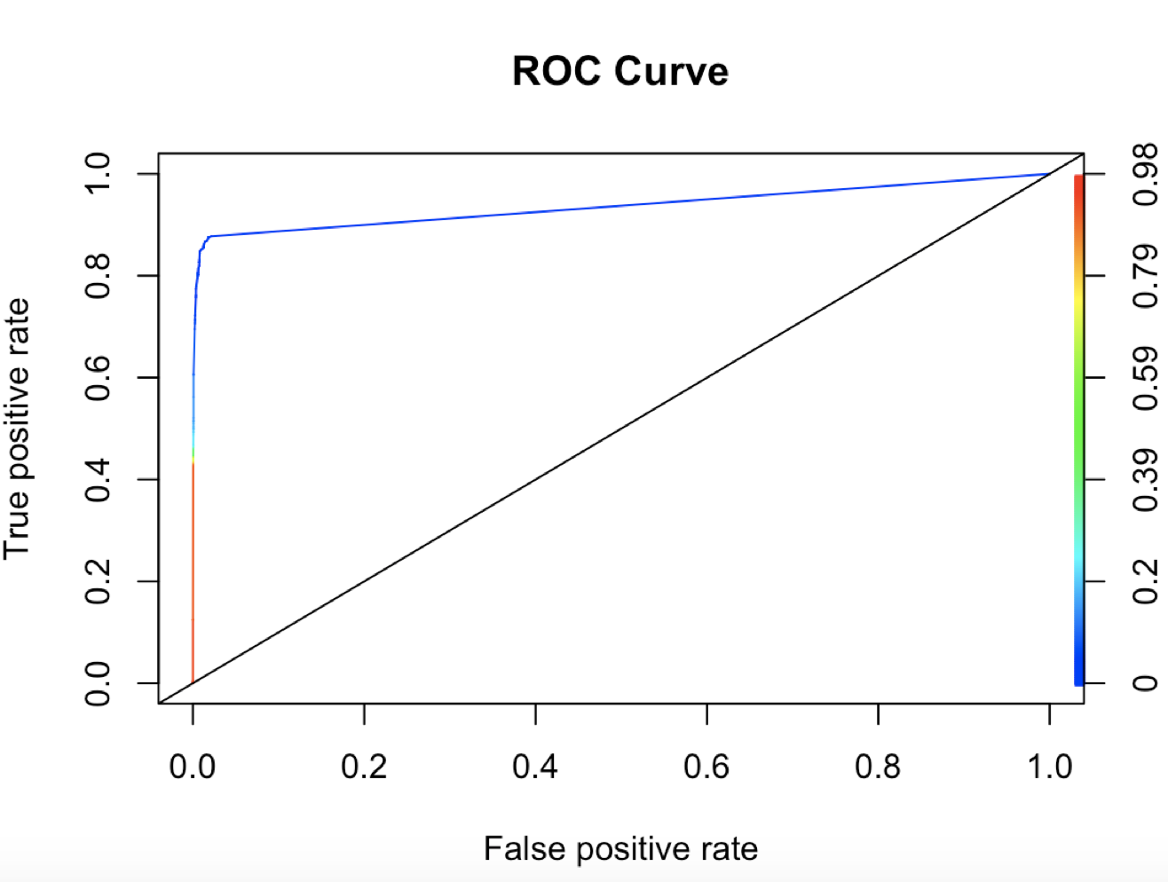
RESULTS
Boosting : RESULTS
819
1015
205
497961
AUC SCORE :
93.59%
PRECISION :
79.98%
TRUE POSITIVE RATE :
44.66%

Slide 18
1
Business Problem
2
Data Description
3
Feature Selection
4
Statistical Methods
5
Final Approach
6
Result
7
Future Prospect

Slide 19
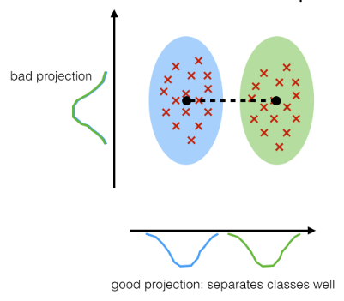
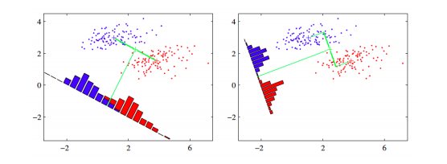
STATISTICAL METHOD : LDA
Performed on variables obtained from KS
Use LOOCV to tune number of variables to put into model
Targeting on the one with highest AUC (22 variables)

Slide 20
1
Business Problem
2
Data Description
3
Feature Selection
4
Statistical Methods
5
Final Approach
6
Result
7
Future Prospect

Slide 21
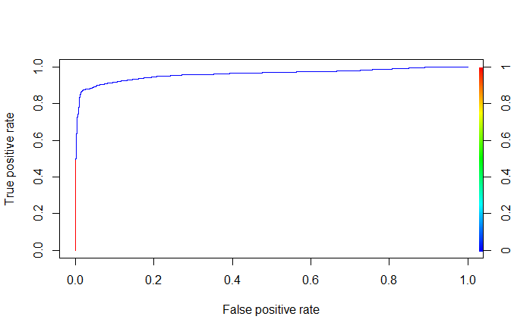
RESULTS
LDA : RESULTS
907
927
547
497961
AUC SCORE :
96.07%
PRECISION :
62.38%
TRUE POSITIVE RATE :
49.45%

Slide 22
RESULTS
LDA : CHANGING THRESHOLD
907
927
1474
360
547
497961
4984
493182
ACCURACY :
99.71%
ACCURACY :
98.93%
PRECISION :
62.38%
PRECISION :
29.57%
TRUE POSITIVE RATE :
49.45%
TRUE POSITIVE RATE :
80.37%

Slide 23
1
Business Problem
2
Data Description
3
Feature Selection
4
Statistical Methods
5
Final Approach
6
Result
7
Future Prospect

Slide 24
Notes:
Now that we’ve seen how the models predict the fraudulent clicks, lets see some business implications that this will have.

Slide 25
Business Implications
Develop better marketing strategies
Using the IP and MAC address
Tradeoff
Change the business model
Understand the algorithm of the bots
Clustering characteristics of true downloads
Segment the fraudulent clicks geographically to target specific locations.
Lose some money but increase goodwill among clients
From cost-per-click (CPC) or cost-per-impressions (CPM) to cost-per-action (CPA) [CPA unit more expensive than CPC or CPM]
Develop a cheat protection for their ads

Slide 26

Thank you

Slide 27
Notes:
This is a summary for handout

